Slide 1
AutoML: Streamlining Machine Learning with Auto-Sklearn
Sanjana Annapureddy
Shalvi Sudhir
Srimukhi Paidikondala

Slide 2
Agenda
Introduction
AutoML Overview and Definitions
Use Cases of AutoML
Example Code Walkthrough
Resources and Further Reading

Slide 3
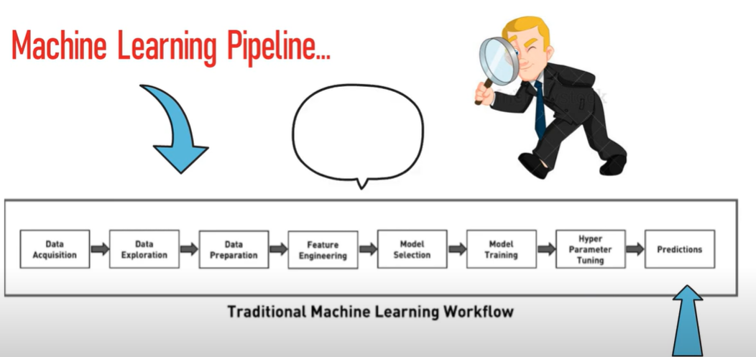
Traditional ML Workflow

Slide 4
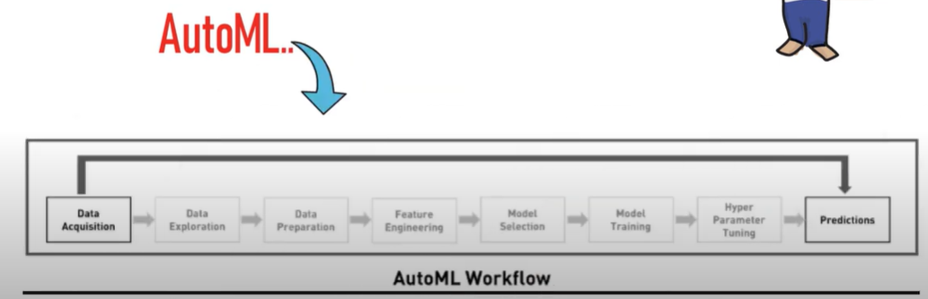
AutoML Workflow

Slide 5
Overview and Definitions
Definitions:
AutoML: Automated machine learning processes, including model selection, hyperparameter tuning, and pipeline optimization.
AutoML (Automated Machine Learning) is about automating the end-to-end process of applying machine learning to real-world problems. It aims to make machine learning more accessible and less time-consuming, especially for those who might not be experts in the field.
Overview:
Introduction to AutoML
Importance in the current landscape
Overview of Auto-Sklearn

Slide 6
Auto-sklearn
What is auto-sklearn?
A Python library for automated machine learning based on scikit-learn.
Key Features:
Automated Model Selection: Chooses the best machine learning algorithms for a given task.
Hyperparameter Optimization: Tunes hyperparameters to enhance model performance.
Ensemble Learning: Combines multiple models to improve prediction accuracy.
Meta-learning: Uses knowledge from previous tasks to improve performance on new tasks.

Slide 7
How auto-sklearn Works?
Input Data: Takes in training data and target labels.
Preprocessing: Automatically handles data preprocessing like normalization and imputation.
Model Selection: Evaluates a wide range of algorithms and selects the best ones based on performance metrics.
Hyperparameter Tuning: Utilizes techniques like Bayesian optimization to fine-tune model parameters.
Ensembling: Constructs an ensemble of the best-performing models to make final predictions.

Slide 8
Use Cases
When to Use:
Rapid prototyping of models
Automating hyperparameter tuning and model selection
When Not to Use:
Custom model architectures
Very large datasets
Advantages:
Saves time and effort
Automates repetitive tasks
Provides a strong baseline model
Limitations:
May not find the most optimal model in complex scenarios
Computationally expensive for large datasets
Limited customization

Slide 9
Example Code Walkthrough
Setup and installation- Setting up the required software and dependencies
Importing necessary libraries- Importing essential libraries for the project.
Loading and preprocessing the dataset- Loading and preparing the dataset for analysis.
Training a model with Auto-Sklearn- Using Auto-Sklearn to build the model.
Evaluating model performance- Checking how well the model performs.
Interpreting the results- Understanding the model's outputs and implications.

Slide 10
Resources and Further Reading
Research Paper: Auto-Sklearn 2.0
GitHub Repository: Auto-Sklearn GitHub

Slide 11
Thank you

